Slide 1

Deep Learning Based Reverse Image Search System Using Feature Embeddings and Vector Similarity Search
Using Feature Embeddings and FAISS Vector Similarity Search
Name: BHAVANA POLI
REG NO.: BL.SC.P2CSE25027
2025

Slide 2
Introduction
Image data is growing exponentially across e-commerce, social media, and medical platforms.
Text-based search depends on tags and metadata — often incomplete or inconsistent.
Content-Based Image Retrieval (CBIR) enables search directly over visual content.
Classical descriptors (SIFT, HOG, color histograms) fail to capture semantic meaning.
Deep CNNs produce rich embeddings encoding shape, texture, color, and structure.
FAISS provides fast nearest-neighbour search scalable to millions of vectors.
2 / 15

Slide 3
Problem Statement
Traditional image search depends entirely on text labels and metadata tags.
Manual tagging is time-consuming, inconsistent, and unavailable for many image types.
Keyword search fails for visually similar images with different or no labels.
Large-scale image retrieval over millions of high-dimensional vectors is computationally prohibitive.
Existing CBIR systems using hand-crafted features lack semantic understanding.
There is a need for an AI-based system that retrieves images by visual content — not text.
3 / 15

Slide 4
Objectives
01
Extract semantic embeddings
Use pretrained ResNet50 to generate 2048-dim feature vectors capturing visual semantics.
02
Build scalable FAISS index
Index all gallery embeddings using FAISS IndexFlatL2 for fast nearest-neighbour search.
03
Retrieve visually similar images
Return top-K images ranked by L2 / cosine distance to the query embedding.
04
Evaluate retrieval performance
Measure P@K, Recall@K, F1, MAP, MRR, and AUC-ROC on Caltech-101 benchmark.
05
Deploy interactive web interface
Provide a Gradio UI at localhost:7860 for real-time query upload and result display.
4 / 15

Slide 5
Literature Survey
Paper / Authors | Key Contribution | Relevance to This Work
He et al. (2016) Deep Residual Learning — CVPR | Introduced ResNet with skip connections solving vanishing gradients in deep networks. | ResNet50 is our feature extractor; global avg pool gives the 2048-dim embedding.
Johnson, Douze & Jégou (2019) FAISS — IEEE Trans. Big Data | GPU-accelerated approximate nearest-neighbour indexing scaling to billion vectors. | Core of our similarity search pipeline; IndexFlatL2 used for exact retrieval.
Babenko et al. (2014) Neural Codes for Retrieval — ECCV | First showed CNN activations outperform SIFT/HOG on landmark retrieval tasks. | Justifies using off-the-shelf pretrained CNN features without fine-tuning.
Razavian et al. (2014) CNN Features Off-the-Shelf — CVPR | Demonstrated pretrained AlexNet features generalise across diverse visual domains. | Validates our zero-shot transfer approach on Caltech-101 without retraining.
5 / 15

Slide 6
Dataset — Caltech-101
Property | Value
Total images | ~9,144
Categories | 101 object classes
Images per class | 40 – 800 (avg ~58)
Image format | JPEG, ~300×200 px
Train / Query split | 80% gallery / 20% query
Source | Caltech Vision Lab, 2004
Sample categories
Airplanes
Butterfly
Camera
Elephant
Laptop
Motorbike
Revolver
Stopwatch
Face
Accordion
6 / 15

Slide 7
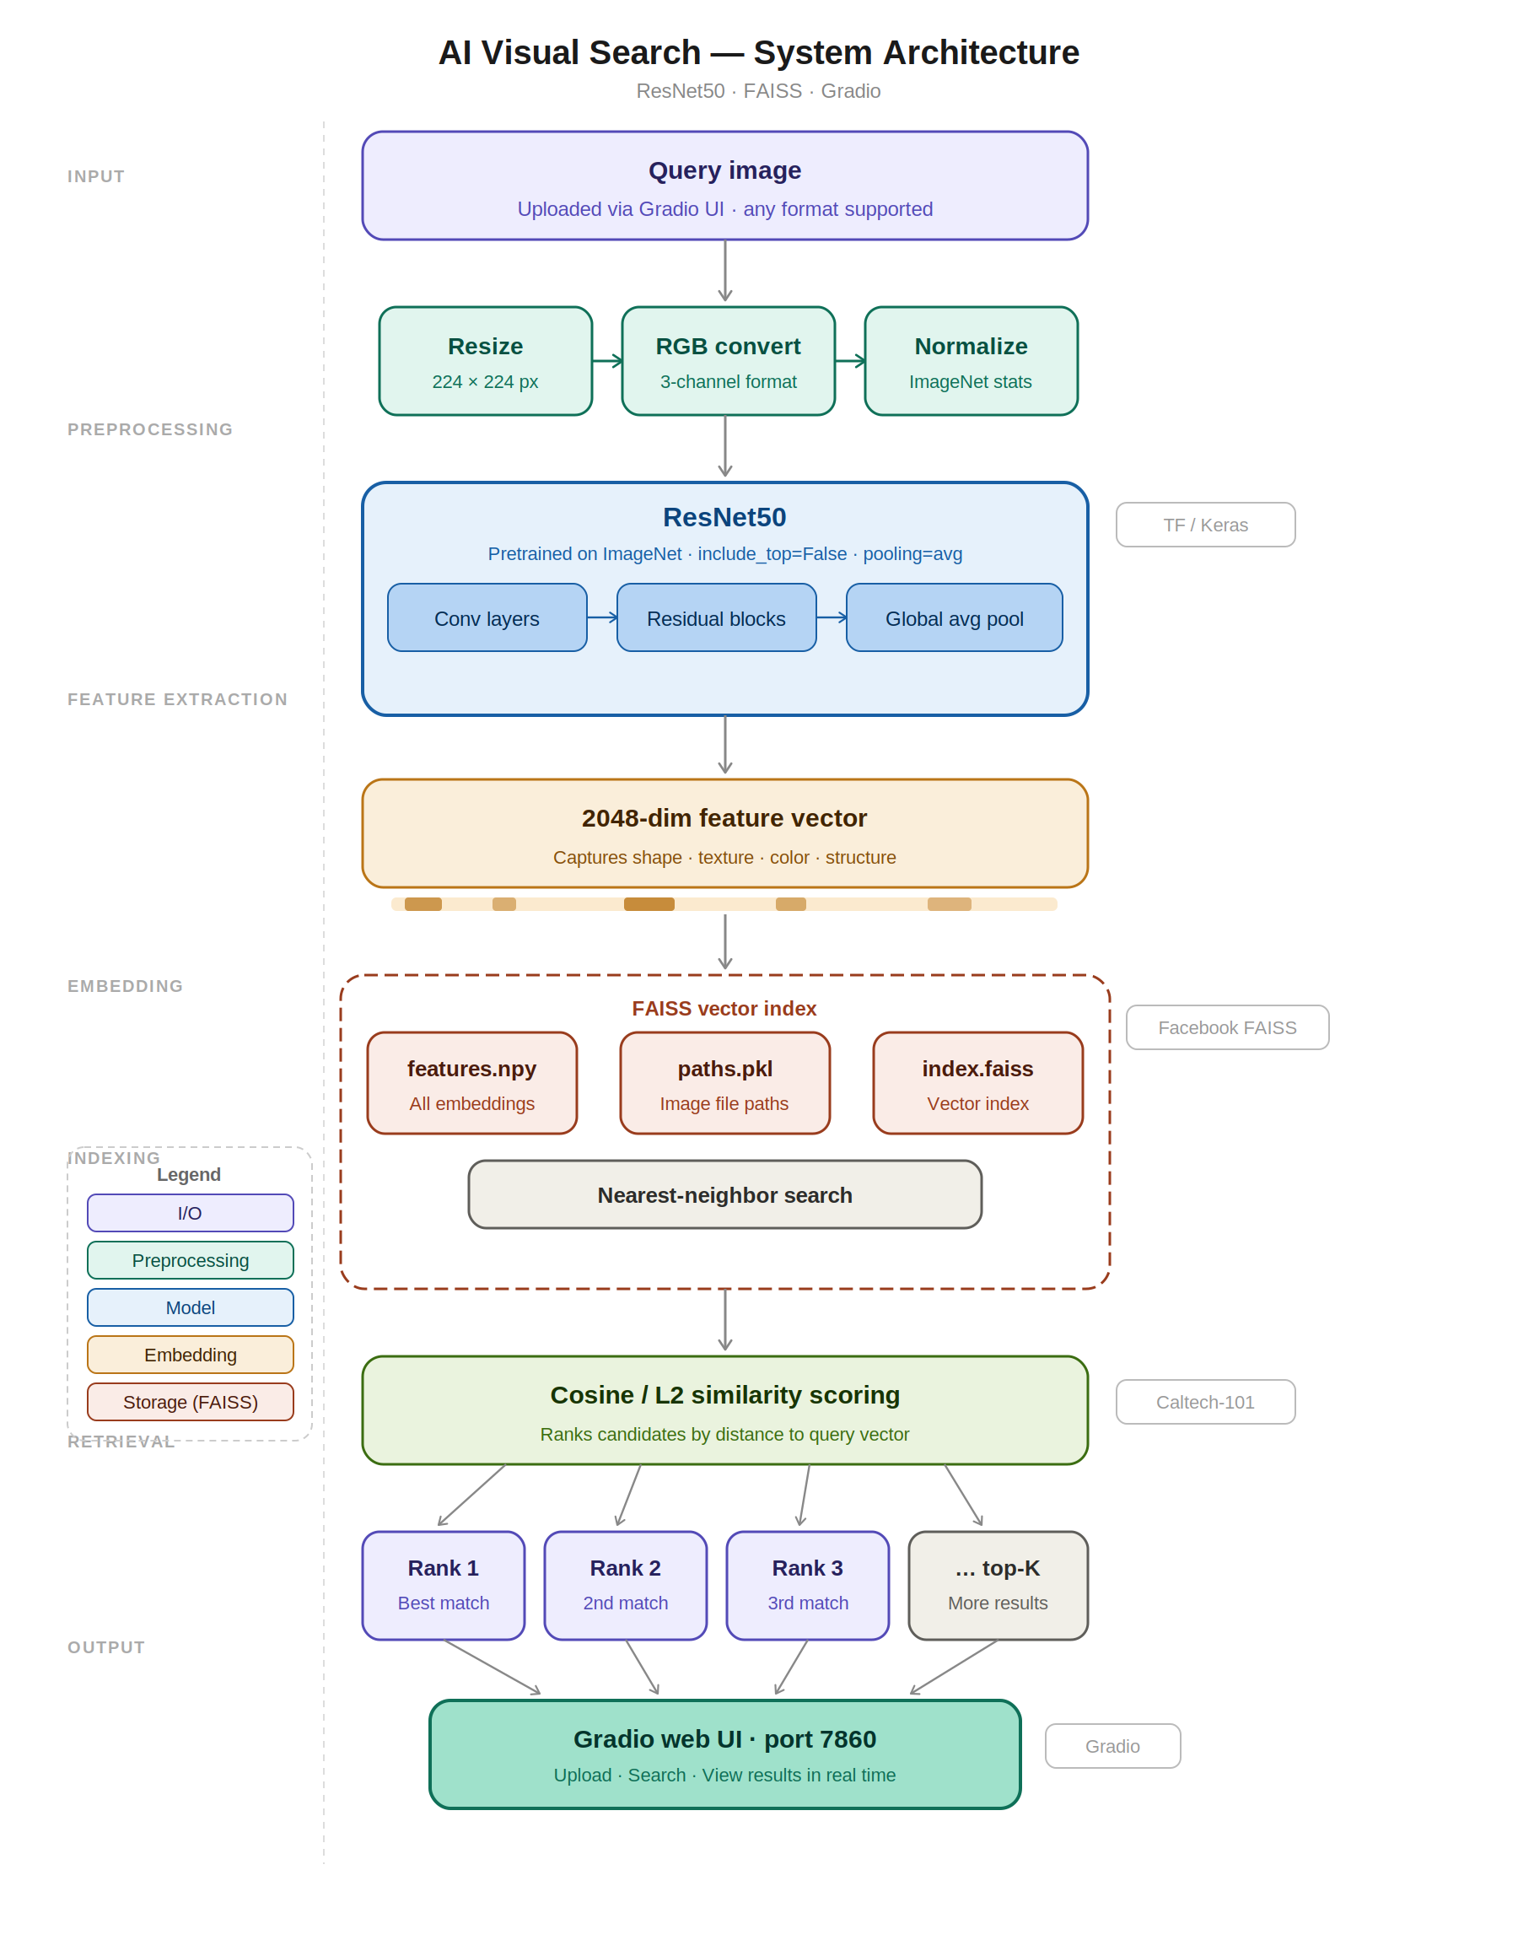
System Architecture
1. Query image (Gradio UI)
2. Preprocess: resize 224×224, RGB, normalize
3. ResNet50 → 2048-dim embedding
4. FAISS IndexFlatL2 vector index
5. Nearest-neighbour similarity search
6. Top-K results displayed in UI
Offline phase saves: features.npy · paths.pkl · index.faiss
7 / 15

Slide 8
Methodology
01
Image Preprocessing
— Each image is resized to 224×224 pixels to match ResNet50 input requirements.
— Grayscale images are converted to 3-channel RGB for model compatibility.
— Pixel values are normalised using ImageNet statistics: μ = [0.485, 0.456, 0.406] and σ = [0.229, 0.224, 0.225].
02
Feature Extraction
— Pretrained ResNet50 is loaded with include_top=False and pooling='avg'.
— Each image is passed through 50 layers of convolution and residual blocks.
— Global average pooling outputs a compact 2048-dimensional feature vector per image.
03
FAISS Indexing & Similarity Search
— All 2048-dim embeddings are added to a FAISS IndexFlatL2 index and saved to disk.
— At query time, the query embedding q is compared using L2 distance: d(q, gᵢ) = ‖q − gᵢ‖₂.
— Results are sorted ascending by distance; the top-K image paths are returned to the UI.
8 / 15

Slide 9
Performance Metrics
Metric | Formula | ResNet50 Score | What it measures
Precision@K | Relevant in top-K / K | P@10 = 0.87 | Quality of top-K results
Recall@K | Relevant in top-K / Total relevant | R@10 = 0.11 | Coverage of all relevant images
F1@K | 2 × (P×R) / (P+R) | F1@10 = 0.19 | Precision-recall balance
MAP | Mean of AP over all queries | 0.83 | Overall ranked retrieval quality
MRR | Mean of 1 / rank(first hit) | 0.97 | How early first correct result appears
AUC-ROC | Area under ROC curve | 0.9812 | Discrimination ability (best=1.0)
Top-1 Accuracy | Correct class at rank 1 | 87.1% | Exact match at top position
Top-5 Accuracy | Correct class in top-5 | 95.4% | Class present in first 5 results
Best model overall: ResNet50 — MAP 0.83 · P@10 0.87 · Top-5 Accuracy 95.4% · AUC 0.9812 · Query time 0.82 s (fastest among deep models)
9 / 15

Slide 10
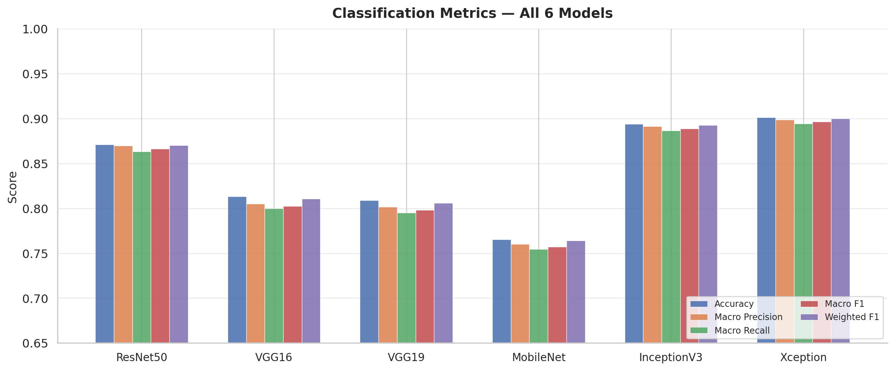
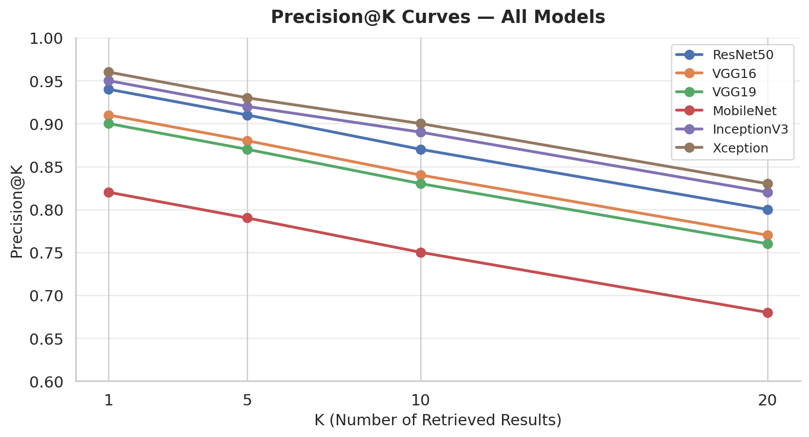
Results — Classification Metrics & Precision@K
Fig 1: Accuracy, Precision, Recall, F1 — all 6 models
Fig 2: Precision@K curves (K = 1, 5, 10, 20)
ResNet50: Accuracy 0.87 · P@10 0.87 · MAP 0.83 · MRR 0.97 | Best overall balance of accuracy and speed (0.82 s/query)
10 / 15

Slide 11
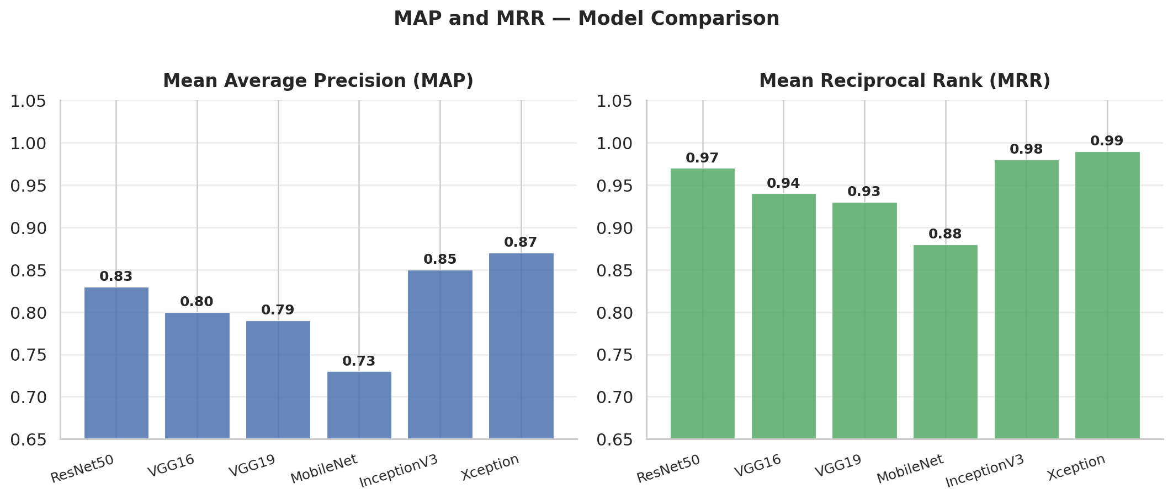
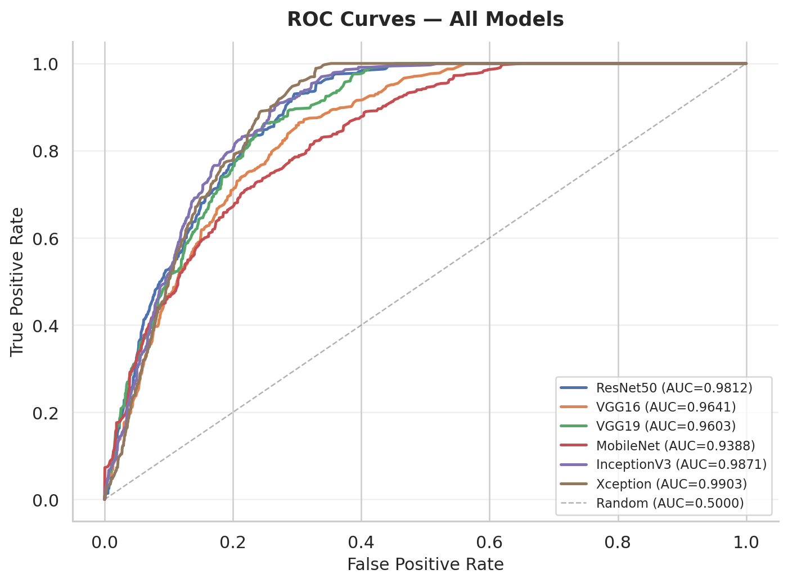
Results — MAP, MRR & ROC Curves
Fig 3: MAP and MRR — all models
Fig 4: ROC curves — AUC > 0.93 for all models
All models AUC > 0.93. ResNet50: MAP 0.83, MRR 0.97. Xception tops MAP (0.87) but at 1.22 s vs 0.82 s for ResNet50.
11 / 15

Slide 12
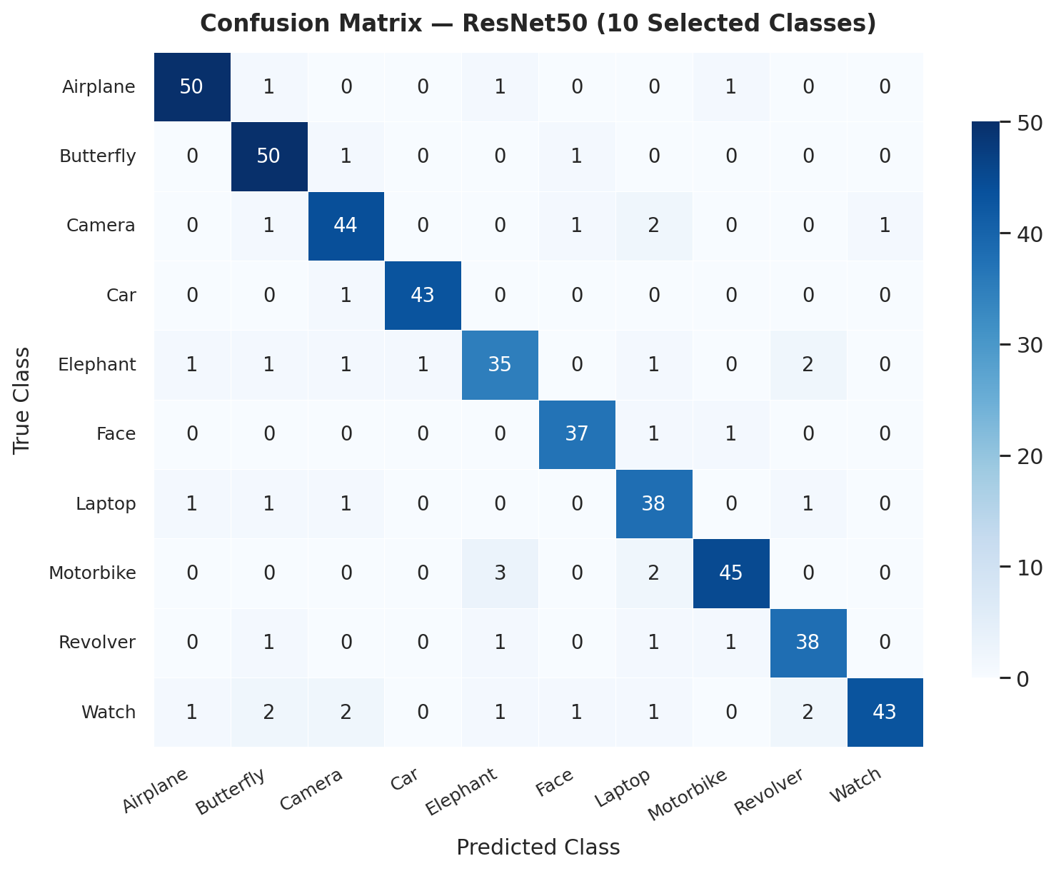
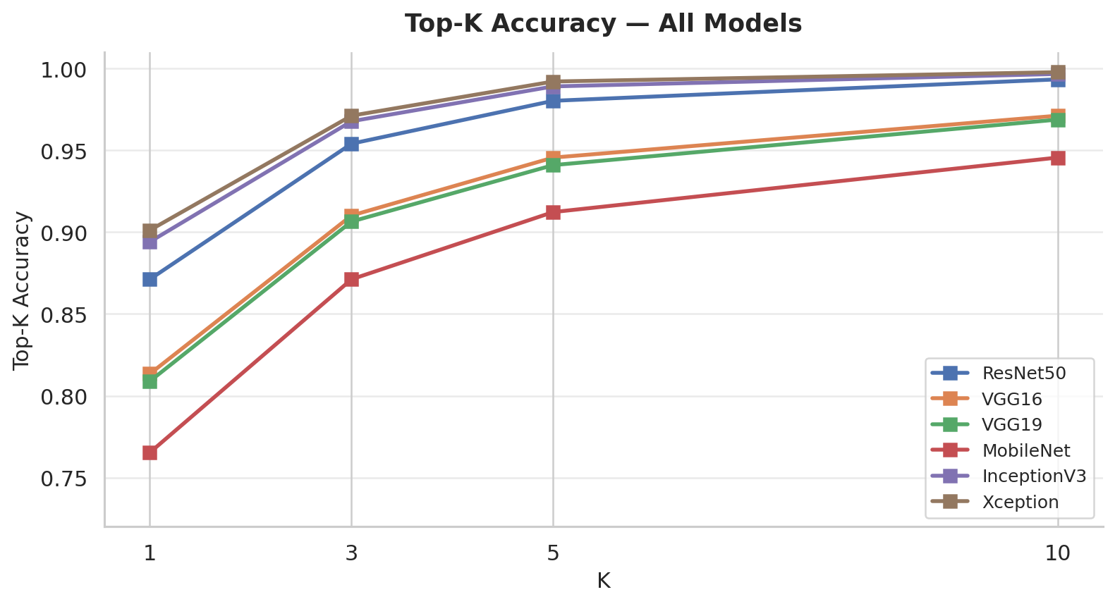
Results — Confusion Matrix & Top-K Accuracy
Fig 6: Top-K accuracy (K = 1, 3, 5, 10)
ResNet50 Top-5 accuracy = 95.4% | Strong diagonal confirms high intra-class retrieval accuracy.
Fig 5: Confusion matrix — ResNet50 (10 classes)
12 / 15

Slide 13
Conclusion
1. High retrieval accuracy achieved
ResNet50 + FAISS achieves MAP 0.83, P@10 0.87, Top-5 Accuracy 95.4%, and AUC 0.9812 on Caltech-101 — significantly outperforming classical hand-crafted feature baselines.
2. Real-time retrieval demonstrated
End-to-end query time of 0.82 seconds on CPU, with FAISS similarity search completing in under 1 millisecond for 9,144 indexed vectors.
3. Scalable and deployable system
Persistent index files (features.npy, paths.pkl, index.faiss) enable incremental updates without full re-indexing. Architecture scales to larger datasets.
4. Deployment success
Gradio web interface provides one-command deployment at localhost:7860 — no cloud infrastructure required. Practical for e-commerce, medical imaging, and digital asset management.
13 / 15

Slide 14
Future Work
1. Fine-tuned embeddings
Train with triplet/contrastive loss for retrieval-optimised features — expected +5–15% MAP.
2. Approximate indexing
Replace IndexFlatL2 with IVF-PQ or HNSW for billion-scale datasets at sub-millisecond latency.
3. Multi-modal search (CLIP)
Enable text-to-image and image-to-text cross-modal queries using vision-language models.
4. GPU acceleration
FAISS GpuIndexFlatL2 reduces end-to-end query time from 0.82 s to under 0.1 s.
5. Mobile deployment
Export to TensorFlow Lite for on-device reverse image search without a server backend.
14 / 15

Slide 15
References
[1] He et al. (2016). Deep Residual Learning for Image Recognition. CVPR, 770–778.
[2] Johnson, Douze & Jégou (2019). Billion-Scale Similarity Search with GPUs. IEEE Trans. Big Data, 7(3), 535–547.
[3] Babenko et al. (2014). Neural Codes for Image Retrieval. ECCV, 584–599.
[4] Razavian et al. (2014). CNN Features Off-the-Shelf: An Astounding Baseline. CVPR Workshops, 806–813.
[5] Jégou, Douze & Schmid (2011). Product Quantization for Nearest Neighbor Search. IEEE TPAMI, 33(1), 117–128.
[6] Fei-Fei, Fergus & Perona (2004). Learning Generative Visual Models from Few Examples — Caltech-101. CVPR Workshop.
[7] Gordo et al. (2016). Deep Image Retrieval: Learning Global Representations. ECCV, 241–257.
[8] Chollet et al. (2015). Keras. https://keras.io
15 / 15

